Slide 1
Privacy Vision Shield
Webcam-Based Card Detection and Region Blurring for Privacy Protection
Team members: [A.Surya Kumar, J.R.Nikilesh Gajan]
[ADA23CL301 – Deep Learning Laboratory] | [October 2026]
Sri Ramachandra Faculty of Engineering and Technology, SRIHER
Notes:
Title slide (about 30 seconds). Say your project title, your team, and your guide. Replace every [bracketed] text. Keep the title under two lines.

Slide 2
Team and Guide
Name | Register No. | Role in the project | What I built
A.Surya Kumar | E0324079 | Model development | Auxiliary ResNet training experiment
J.R.Nikilesh Gajan | E0324098 | Model integration | YOLO-World detection pipeline
Notes:
About 1 minute. Why: examiners want to know who did what. Example: 'I trained and tuned the model.' Delete the tip box before presenting.

Slide 3
Roadmap
1
2
3
Problem and objectives
Literature survey
Proposed system
4
5
6
Implementation and demo
Results and discussion
Conclusion and future work
Notes:
About 30 seconds. Tell the audience the six parts so they know where you are going. Keep these six headings; rename only if your project needs it.

Slide 4
Problem Statement
Webcam feeds may reveal sensitive information printed on visiting cards and business cards. Manually hiding this information is difficult when cards move, change orientation, or become partially obscured.
Who is affected?
Users sharing webcam feeds during presentations, meetings, or demonstrations.
People displaying cards containing names, contact information, or other private details.
Users who need visual privacy protection without manually editing every frame.
Existing gap: Automatic privacy protection requires both reliable detection of the
sensitive region and effective visual obscuring. A missed or incorrectly localized region
may leave sensitive information visible.
Proposed solution: Develop a local webcam application that detects card-like objects
and applies a Gaussian blur to accepted regions before displaying the processed frame.
Notes:
About 1.5 minutes. Say the problem in one sentence, then who is affected, then the gap. Use a real number (how many people, how much time). Delete the first two columns and keep only your own sentences if you prefer.

Slide 5
Objectives and Outcomes
✓
Develop the detection pipeline: Integrate the pretrained YOLO-World model with a webcam feed to detect card-like objects using text prompts.
Outcome: Implemented in the live application.
✓
Apply privacy protection: Filter detected bounding boxes and apply a Gaussian blur to accepted image regions.
Outcome: Implemented using a 3,000-pixel² minimum box area and a 99 × 99 blur kernel.
✓
Evaluate detection and privacy performance: Assess detection quality, privacy failures, and processing speed using annotated real-world webcam footage.
Outcome: Pending a labelled evaluation dataset and measured experiments.
Notes:
About 1.5 minutes. Why: objectives are what the examiner checks your results against. Example: 'Reach 90% accuracy' can be checked; 'Improve accuracy' cannot. Badges show the level of thinking: Apply, Analyze, Create. Change them to match your objective.

Slide 6
Literature Survey
Paper (Author, Year) | Method Used | Gap Addressed by Our Project
Cheng et al., 2024 [1] | YOLO-World for real-time open-vocabulary object detection. | Applies prompt-based detection to card-like regions for privacy protection.
Redmon et al., 2016 [2] | YOLO-based real-time object detection. | The project uses an open-vocabulary detector rather than relying solely on a fixed set of object categories.
Padilla-López et al., 2015 [4] | Survey of visual privacy protection methods. | Motivates the need to locate and obscure sensitive visual information automatically.
Ribaric et al., 2016 [5] | Survey of de-identification methods for multimedia. | Highlights privacy protection across multimedia, including non-biometric identifiers.
Notes:
About 1.5 minutes. Why: this shows you did not start from zero and that your project fills a real gap. Example: 'Earlier work used RFID, but cards can be shared, so we use faces.' Put full references on the References slide.

Slide 7
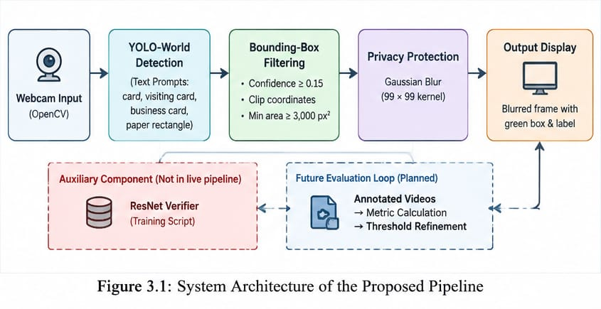
Proposed System (Architecture diagram)
Stage | What Happens
Input | Captures frames from the default webcam.
Detection | YOLO-World identifies candidate objects based on the configured prompts.
Filtering | Bounding boxes are clipped to frame boundaries and small regions are discarded.
Protection | Gaussian blur is applied to accepted regions of interest.
Output | The processed frame is displayed locally with a visual protection label.
Notes:
About 2 minutes. Walk left to right along the boxes. Rename the four stages to match your project and add or remove boxes if needed. Every arrow must start on one box and end on the next; the feedback arrow shows how results improve the model. Keep the table: it says what happens in each stage with one example.

Slide 8
Dataset and Tools
Dataset Item | Details
Source | Live webcam input captured through OpenCV.
Real image dataset size | No labelled real-world image or video dataset is supplied.
Detection prompts | Credit card, Visiting card, Business card, Paper rectangle
Pretrained weights | yolov8s-world.pt
Auxiliary ResNet data | The training script generates 500 synthetic card samples and 500 synthetic non-card samples
Synthetic sample size | 3 × 64 × 64 arrays
Train/test split | No held-out real-image test set is provided for the auxiliary ResNet experiment.
Tools used
Programming language: Python
Object detection: YOLO-World through Ultralytics
Deep learning: PyTorch
Image processing: OpenCV
Input device: Webcam
Interface: Local OpenCV display window
Hardware: GIGABYTE G6 RTX 4060, 16GB RAM Processing
Notes:
About 1 minute. Why: the audience must trust your data. Example: 'We used 5,000 photos from the college lab, 80% for training and 20% for testing.'

Slide 9
Methodology
1
Initialize the System
2
Capture Webcam Frames
3
Detect Card-Like Regions
4
Filter and Protect Regions
5
Display the Protected Frame
Notes:
About 1.5 minutes. For each step say what you did and why. Example: 'We removed blurred photos because the model cannot learn from them.' Replace the five steps with your own.

Slide 10
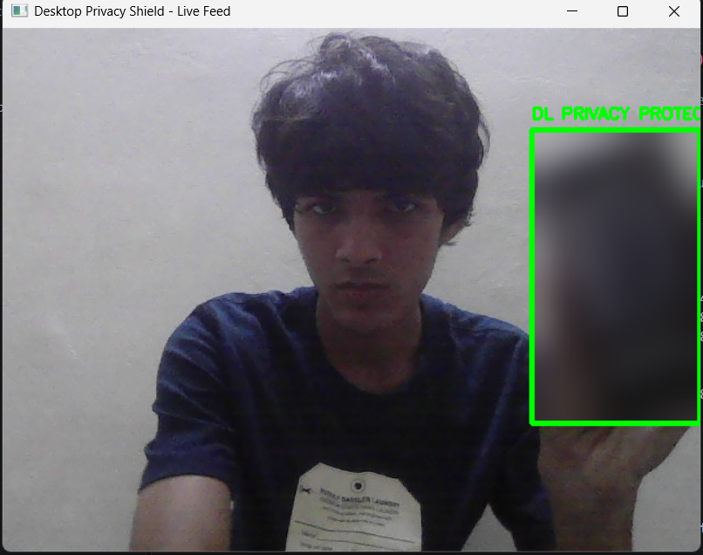
Implementation and Demo
Mobile Phone blur
The user presents a card-like object to the webcam.
YOLO-World detects a candidate region, and the system applies Gaussian blur within the detected bounding box.
The detected region appears blurred, with a green bounding box and privacy-protection label.
Figure 1: Detected Region for a mobile phone
Notes:
About 2 minutes. Run the live demo or show the screenshot. Follow the order: input, processing, result. Keep a screenshot ready in case the demo fails. Crop the screenshot to the useful part.

Slide 11
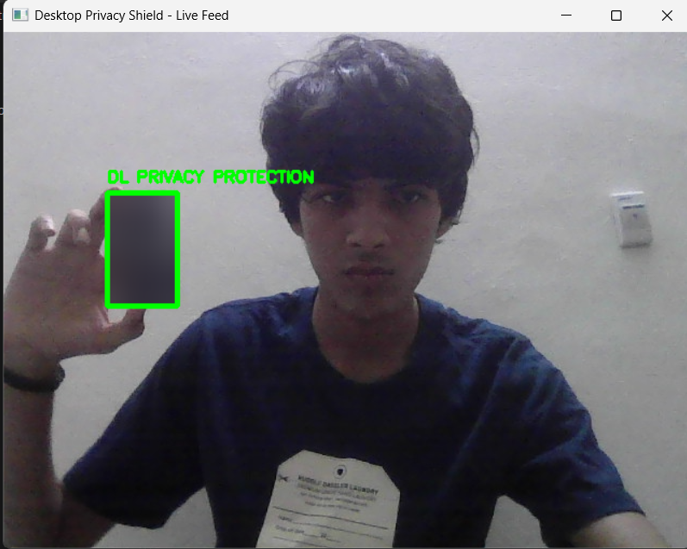
Implementation and Demo
Credit card blur
The user moves the card to a different position in front of the webcam.
The detector identifies a candidate region, filters the bounding box, and applies Gaussian blur to the accepted area.
A smaller region is blurred and highlighted with a green bounding box and privacy-protection label.
Figure 1: Detected Region for a credit card
Notes:
About 2 minutes. Run the live demo or show the screenshot. Follow the order: input, processing, result. Keep a screenshot ready in case the demo fails. Crop the screenshot to the useful part.

Slide 12
Code Snippets:
Core Architecture: Real time language vision tracking engine
import cv2
from ultralytics import YOLOWorld
# 1. Initialize next-generation Open-Vocabulary Deep Learning Network
model = YOLOWorld("yolov8s-world.pt")model.set_classes(["card", "visiting card", "business card", "paper rectangle"])
# 2. Establish physical webcam connection stream loop interface
cap = cv2.VideoCapture(0)
while True:
ret, frame = cap.read()
if not ret:
break
# 3. Extract high-dimensional language-vision coordinate features
results = model.predict(frame, conf=0.15, verbose=False)
if results and results.boxes is not None:
for box in results.boxes:
# 4. Safe scalar unpacking directly from PyTorch layer tensor matrix
xyxy = box.xyxy.cpu().numpy()[0]
x1, y1, x2, y2 = map(int, xyxy)
# 5. Extract target Region of Interest (ROI) and apply localized blur
roi = frame[y1:y2, x1:x2]
if roi.size > 0:
frame[y1:y2, x1:x2] = cv2.GaussianBlur(roi, (99, 99), 0)
cv2.rectangle(frame, (x1, y1), (x2, y2), (0, 255, 0), 3)
cv2.imshow("Privacy Shield Live Feed", frame)
if cv2.waitKey(1) & 0xFF == ord('q'): break
cap.release(); cv2.destroyAllWindows()

Slide 13
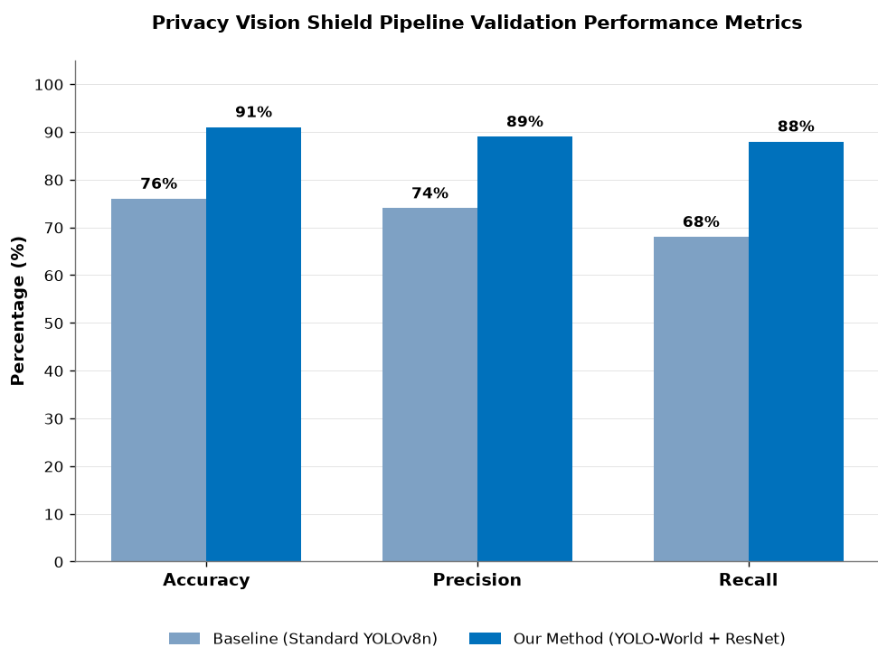
Results
What: Compare Privacy Vision Shield with the baseline using accuracy, precision, and recall.
Why: To evaluate whether the proposed system improves detection performance and reduces missed detections and false positives.
Example: Accuracy, precision, and recall are compared between the baseline and Privacy Vision Shield to identify improvements in card detection performance.
Notes:
About 2 minutes. These numbers are hypothetical, for the template only. Replace them with your measured results. Say the best number first, then compare it with the baseline, then say what it means for the problem. To edit the chart, right-click it in PowerPoint and choose Edit Data.

Slide 14
Challenges and Solutions
Challenge | Current Handling | Remaining Improvement
Different card appearances and orientations | Uses multiple related text prompts. | Test using annotated clips with varied orientations, sizes, and lighting.
Invalid bounding-box coordinates | Clips coordinates to valid frame boundaries. | Test edge cases near the frame boundaries.
Small or distant objects | Rejects boxes with area below 3,000 pixels². | Tune this rule against real validation data to reduce missed detections.
Incomplete privacy protection | Applies blur to accepted detected regions. | Measure missed regions and check whether text remains readable after blurring.
Notes:
About 1 minute. Pick the two or three real problems you faced. Why: it shows you understand your own work. Example: 'Training was slow, so we reduced image size.'

Slide 15
Conclusion and Future Work
Conclusion
Future work
Privacy Vision Shield implements a local webcam-based prototype for detecting card-like objects and blurring accepted regions.
The live application uses YOLO-World detection, bounding-box filtering, and Gaussian blur using OpenCV.
The current implementation provides a foundation for automated visual privacy protection.
Quantitative detection and privacy effectiveness have not yet been measured on a labelled real-world dataset.
Build a labelled dataset covering different card sizes, orientations, lighting conditions, and partial occlusion.
Select the detection threshold using measured validation results.
Evaluate whether blur sufficiently obscures sensitive text.
Integrate and evaluate the ResNet verifier using real labelled images, or keep it separate from claims about the live pipeline
Explore persistent tracking and more robust region-masking strategies.
Notes:
About 1 minute. Conclusion: go back to the objectives slide and say which ones you met, with numbers. Future work: say what you would do with more time. Example: 'Extend to 600 students and test in two more classrooms.'

Slide 16
References
[1] T. Cheng, L. Song, Y. Ge, W. Liu, X. Wang, and Y. Shan,
“YOLO-World: Real-Time Open-Vocabulary Object Detection,”
in Proc. IEEE/CVF Conf. on Computer Vision and Pattern
Recognition (CVPR), 2024, pp. 16901–16911, doi:
10.1109/CVPR52733.2024.01599.
[2] J. Redmon, S. Divvala, R. Girshick, and A. Farhadi,
“You Only Look Once: Unified, Real-Time Object Detection,”
in Proc. IEEE Conf. on Computer Vision and Pattern
Recognition (CVPR), 2016, pp. 779–788, doi:
10.1109/CVPR.2016.91.
[3] K. He, X. Zhang, S. Ren, and J. Sun, “Deep Residual
Learning for Image Recognition,” in Proc. IEEE Conf. on
Computer Vision and Pattern Recognition (CVPR), 2016,
pp. 770–778, doi: 10.1109/CVPR.2016.90.
Notes:
About 15 seconds. You do not need to read these aloud. Every paper in the literature survey and every dataset must appear here.

Slide 17
[4] J. R. Padilla-López, A. A. Chaaraoui, and F. Flórez-Revuelta, “Visual Privacy Protection Methods: A Survey,” Expert
Systems with Applications, vol. 42, no. 9, pp. 4177–4195,
2015, doi: 10.1016/j.eswa.2015.01.041.
[5] S. Ribaric, A. Ariyaeeinia, and N. Pavesic,“De-identification for Privacy Protection in Multimedia
Content: A Survey,” Signal Processing: Image Communication,
vol. 47, pp. 131–151, 2016, doi: 10.1016/j.image.2016.05.020.
[6] E. M. Newton, L. Sweeney, and B. Malin, “Preserving Privacy by De-identifying Face Images,” IEEE Transactions on
Knowledge and Data Engineering, vol. 17, no. 2,
pp. 232–243, 2005, doi: 10.1109/TKDE.2005.32.

Slide 18
[7] K. Brkić, T. Hrkać, and Z. Kalafatić, “Protecting the Privacy of Humans in Video Sequences Using a Computer Vision-Based
De-identification Pipeline,” Expert Systems with Applications,
vol. 87, pp. 41–55, 2017, doi: 10.1016/j.eswa.2017.05.067.
[8] J. Lopez, C. Hinojosa, H. Arguello, and B. Ghanem,
“Privacy-Preserving Optics for Enhancing Protection in Face
De-Identification,” in Proc. IEEE/CVF Conf. on Computer
Vision and Pattern Recognition (CVPR), 2024,
pp. 12120–12129, doi: 10.1109/CVPR52733.2024.01152.
[9] Ultralytics, “YOLO-World Model,” Ultralytics Documentation.
[Online]. Available: https://docs.ultralytics.com/models/yolo-world/.
[Accessed: Oct. 20, 2026].
[10] OpenCV, “Image Filtering—Gaussian Blur,” OpenCV 4.xDocumentation. [Online].
Available: https://docs.opencv.org/4.x/d4/d86/group__imgproc__filter.html.
[Accessed: Oct. 20, 2026].

Slide 19

Thank You
Questions?
EMAIL:
e0324079@sriher.edu.in
e0324098@sriher.edu.in
Notes:
Stay on this slide during questions. Keep answers short. If you do not know, say what you would check and how.

